Slide 1
neffy®
(epinephrine nasal spray)
Introduction & How to Use
Please see full Important Safety Information throughout and full Prescribing Information for neffy at neffyPRO.com

Slide 2
Disclaimers
  The information being presented is consistent with the US FDA-approved label for neffy (epinephrine nasal spray), US FDA regulations and medical guidance
  ARS does not recommend the use of its product outside of the US FDA Label
  This slide deck is provided for educational and training purposes only

Slide 3
neffy Important Information (1/2)
INDICATION
neffy 2 mg is indicated for emergency treatment of type I allergic reactions, including anaphylaxis, in adult and pediatric patients who weigh 30 kg or greater.
IMPORTANT SAFETY INFORMATION
It is recommended that patients are prescribed and have immediate access to two neffy nasal sprays at all times. In the absence of clinical improvement or if symptoms worsen after initial treatment, administer a second dose of neffy in the same nostril with a new nasal spray starting 5 minutes after the first dose.
neffy is for use in the nose only.
Advise patients when to seek emergency medical assistance for close monitoring of the anaphylactic episode and in the event further treatment is required.
Absorption of neffy may be affected by underlying structural or anatomical nasal conditions.
Administer with caution to patients who have heart disease; epinephrine may aggravate angina pectoris or produce ventricular arrhythmias. Arrhythmias, including fatal ventricular fibrillation, have been reported, particularly in patients with underlying cardiac disease or taking cardiac glycosides, diuretics, or anti-arrhythmics.
The presence of a sulfite in neffy should not deter use.

Slide 4
neffy Important Information (2/2)
.IMPORTANT SAFETY INFORMATION
neffy may alter nasal mucosa for up to 2 weeks after administration and increase systemic absorption of nasal products, including neffy.
Patients with certain medical conditions or who take certain medications for allergies, depression, thyroid disorders, diabetes, and hypertension, may be at greater risk for adverse reactions.
Epinephrine can temporarily exacerbate the underlying condition or increase symptoms in patients with the following: hyperthyroidism, Parkinson’s disease, diabetes, renal impairment. Epinephrine should be administered with caution in patients with these conditions, including elderly patients and pregnant women.
Adverse reactions to neffy may include mostly mild throat irritation, intranasal paresthesia, headache, nasal discomfort, feeling jittery, paresthesia, fatigue, tremor, rhinorrhea, nasal pruritus, sneezing, abdominal pain, gingival pain, hypoesthesia oral, nasal congestion, dizziness, nausea, and vomiting.
These are not all of the possible side effects of neffy. To report suspected adverse reactions, contact ARS Pharmaceuticals Operations, Inc. at 1-877-MY-NEFFY (877-696-3339) or FDA at 1-800-FDA-1088 or www.fda.gov/medwatch.

Slide 5


Epinephrine Treatment for Type 1 Allergic Reactions Including Anaphylaxis
Epinephrine is indicated as first-line treatment and is the only medication
approved to stop a potentially life-threatening allergic reaction^{1,2}
Early recognition and use of epinephrine to treat symptoms and prevent progression to life-threatening respiratory and/or cardiovascular events¹
Reduce acute care activation and costs through prompt epinephrine usage for potential life-threatening reactions³
1. Golden DBK, et al. Ann Allergy Asthma Immunol. 2024;32(2):124-176; 2. Shaker MS, et al. J Allergy Clin Immunol. 2020;145(4):1082-1123; 3. Fleming JT, et al. J Allergy Clin Immunol Pract. 2015;3(1):57-62.

Slide 6
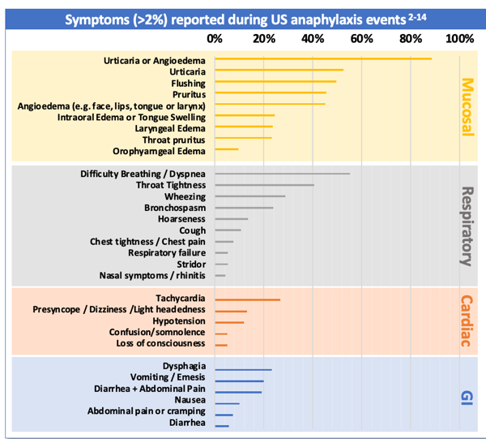
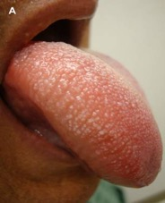
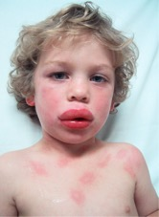
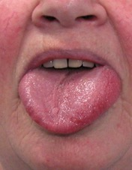
Anaphylaxis is Accompanied by Many Frequent Symptoms
Most Common Anaphylaxis Symptoms Include:
>85%
urticaria (hives, erythema) or angioedema (swelling of the face, lips, tongue or larynx)
>55%
difficult breathing
>40%
gastrointestinal (eg, vomiting, nausea)
References: 1. Shaker MS, et al. J Allergy Clin Immunol. 2020. 2. Pistiner M, et al. J Allergy Clin Immunol Pract. 2021. 3. Jalil M, et al. Abstract at AAAAI 2020 Virtual Meeting. 4. Gonzelez-Estrada A, et al. Ann Allergy Asthma Immunol. 2018. 5. Lee S, et al. J Allergy Clin Immunol. 2017. 6. Lee S, et al. J Allergy Clin Immunol Pract. 2014. 7. Manivannan V, et al. Am J Emerg Med. 2014. 8. Wood RA, et al. J Allergy Clin Immunol 2014. 9. Walsh KE, et al. Pharmacoepidemiol Drug Saf 2013. 10. Decker WW, et al. J Allergy Clin Immunol. 2008. 11. Ross MP, et al. J Allergy Clin Immunol. 2008. 12. Webb LM & Lieberman P. Ann Allergy Asthma Immunol. 2006. 13. Ditto AM, et al. Ann Allergy Asthma Immunol. 1996. 14. Rudders SA, et al. Pediatrics. 2010. Note that some publications do not specify angioedema symptom subtype. Angioedema subtype frequency aggregated when reported.

Slide 7

Delays in Treatment with Epinephrine are Principally due to Needle-Injector Limitations and Accompanying Patient Reluctance
>40% of patients do not fill or refill their epinephrine prescription¹
55%-60% don’t consistently
carry epinephrine²⁻⁴
References: 1. Data on File. ARS Pharmaceuticals. 2023. 2. Warren CM, et al. Ann Allergy Asthma Immunol. 2018. 3. Brooks C, et al. Ann Allergy Asthma Immunol. 2017. 4. Curtis C, et al. Ann Allergy Asthma Immunol. 2014. 5. Chad L, et al. Eur J Allergy Clin Immunol. 2013. 6. Sicherer SH, et al. Pediatrics. 2000. 7. El Turki A, et al. Emerg Med J. 2017.

Slide 8
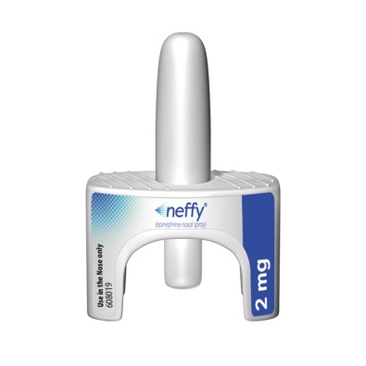
Introduction to neffy® (epinephrine nasal spray)
The same epinephrine in a new device
Approved by FDA on August 9, 2024.
neffy is a compact, ready-to-use nasal spray indicated for emergency treatment of type I allergic reactions, including anaphylaxis, in adult and pediatric patients who weigh 30 kg or greater.
neffy is designed to be easy to use and easy to carry, so treatment is always close at hand.
neffy is well tolerated and has no meaningful pain or irritation.
neffy has some safety advantages over current epinephrine injection devices given the lack of a needle and need for injection. For example, the caregiver or medical professional cannot accidentally inject themselves in the hand or finger with neffy as often happens with injection products.

Slide 9
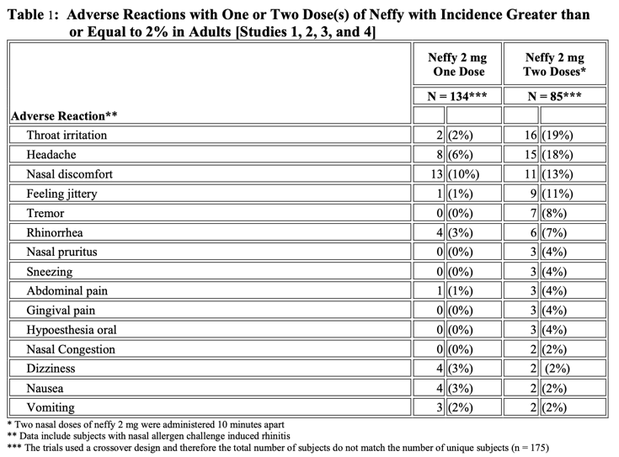
Safety and Tolerability
Most common adverse events (>5%) following one dose were mild nasal discomfort (10%) and mild to moderate headache (6%)
Adverse events generally mild in nature and resolve quickly
No serious adverse events in any clinical studies
No risk of needle-related injuries or blood vessel injections
Notes:
No risk of needle-related injuries or blood vessel injections
Most common adverse events (>5%) following one dose were nasal discomfort (10%) and headache (6%)
Adverse events generally mild in nature
No serious adverse events in any clinical studies

Slide 10
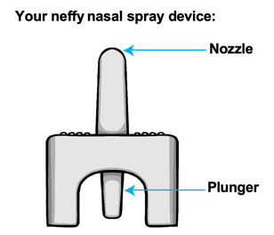
Important Points about Use of neffy
neffy is For Use in the Nose Only
neffy nasal spray device is for allergic emergencies (anaphylaxis) only
Always carry two (2) neffy devices with you as a second dose may be needed (approximately 10% frequency with all epinephrine products)
Do not test or prime (pre-spray) the device. Each neffy can only be sprayed 1 time and only had 1 dose
It is recommended that right-handed dosing should be to the right nostril and left-handed dosing should be to the left nostril
Check your neffy periodically to be sure the expiration date has not passed and replace your neffy before expiration
Get emergency medical help for further treatment of the anaphylactic emergency (anaphylaxis, if needed, after using neffy. If complete response after administration of neffy emergency medical help may not be necessary. Epinephrine is safe to use and is not the cause for emergency medical help, the reason for emergency help is to treat the allergic reaction if epinephrine is not completely effective after dosing.

Slide 11
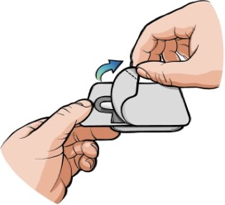
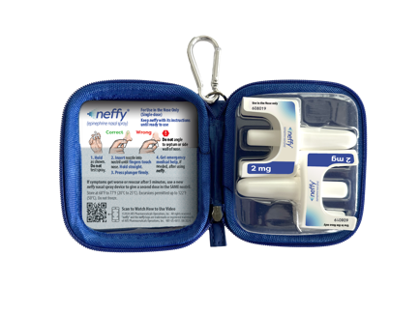
How to use the neffy nasal spray device
Remove neffy from the packaging
Pull open the packaging to remove the neffy nasal spray device from the packaging
neffy may be removed from the original package but should be kept with its instructions, if preferred for improved carriage
ARS Pharmaceuticals (www.neffy.com) provides additional secondary packaging that is convenient to carry and includes appropriate labeling per FDA recommendations in the Prescribing Information

Slide 12
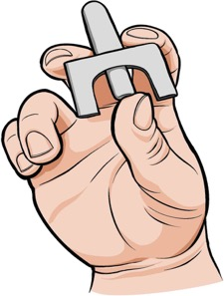
How to use the neffy nasal spray device
Hold device as shown
Hold the device with your thumb on the bottom of the plunger and a finger on either side of the nozzle
Do not pull or push the plunger before activation
Do not test or prime (pre-spray). Each device has only 1 spray (dose).

Slide 13
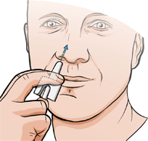
How to use the neffy nasal spray device
Insert the nozzle into a nostril until your fingers touch your nose
Keep the nozzle straight into the nose pointed towards your forehead
Do not point (angle) the nozzle to the nasal septum (wall between your 2 nostrils) or outer wall of the nose.

Slide 14
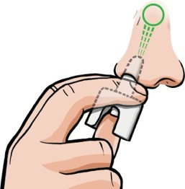
How to use the neffy nasal spray device
Press plunger up firmly until it snaps up and sprays liquid into the nostril
Do not sniff in during or after the dose is given. Sniffing in with neffy has not shown any meaningful difference in absorption but with some nasal product can allow drug to go into the throat.
If any liquid drips out of the nose, you may need to give a second dose of neffy after checking symptoms. If a response is seen within 5 to 10 minutes a second dose may not be necessary.
For Caregiver Administration follow the same recommendations and dosing procedures, but from a caregiver perspective dosing a patient.

Slide 15
How to use the neffy nasal spray device
After dosing neffy
If needed, get additional emergency help for further treatment of the allergic emergency (anaphylaxis). Tell them that a neffy nasal spray has been used to avoid overdose of epinephrine.
Before you receive neffy, your healthcare provider should talk to you about when its appropriate to get emergency medical help.
  For example: If after neffy is administered symptoms resolve and do not reoccur, emergency medical help may not be necessary.
  If a second dose of neffy is needed to control symptoms or symptoms return later (bi-phasic reaction), give neffy first and then get additional emergency medical help to treat the anaphylaxis.

Slide 16
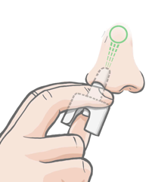
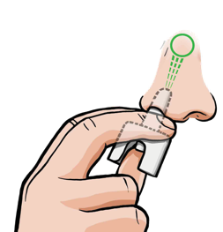
How to use the neffy nasal spray device
After 5 minutes, if symptoms are not responding (getting better), give a repeat dose of neffy
Check for symptoms after the first dose of neffy.
If symptoms get worse or come back, give a second dose of neffy in the same nostril starting at 5 minutes after the dose.
  Note: an additional dose of neffy can be given at any time, if needed, after the first, but not before waiting at least 5 minutes to see if symptoms start to respond.

Slide 17
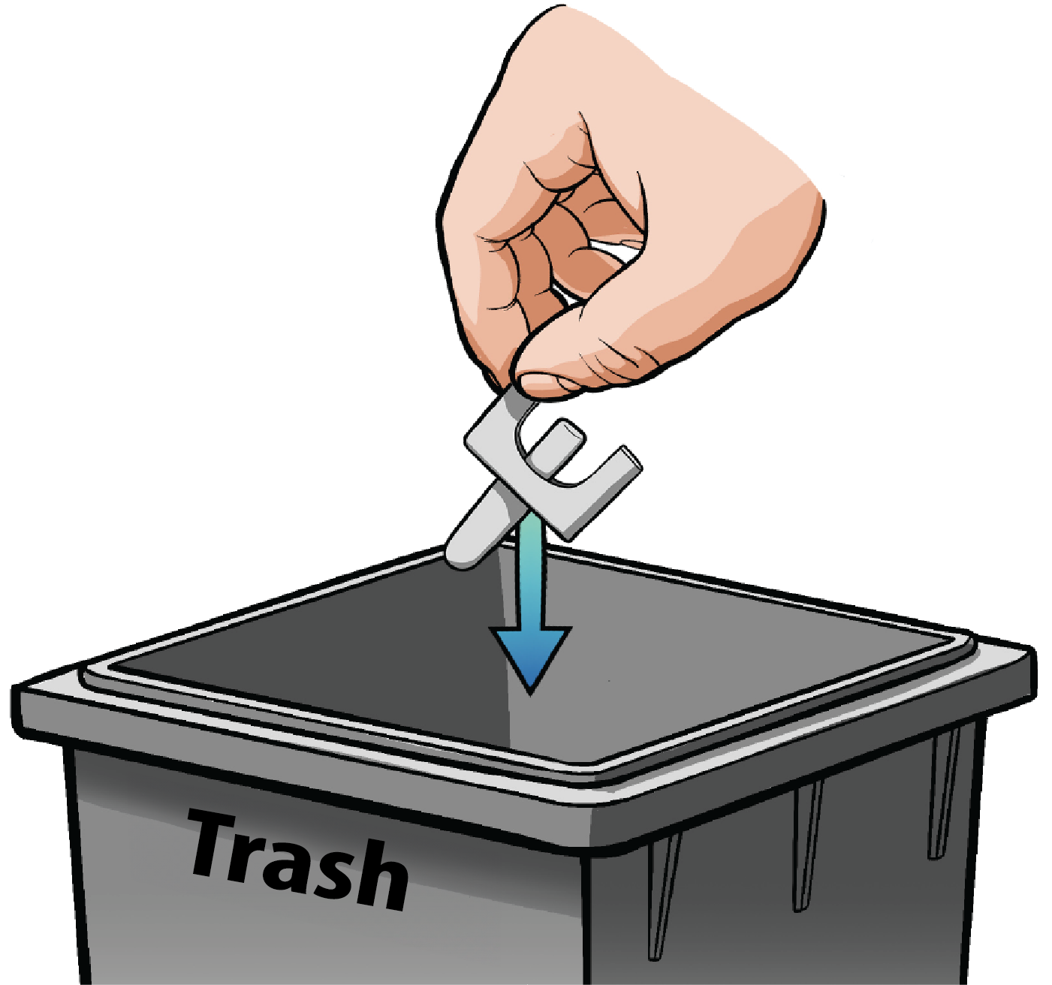
How to use the neffy nasal spray device
Throwing away the used neffy nasal spray device
Throw away (dispose of) the used neffy nasal spray device in household trash.
Do not recycle

Slide 18
Storage and Handling of neffy
How should I store the neffy nasal spray device?
Expiration date of 30 months
Store neffy at room temperature 68°F to 77°F (20°C to 25°C).
Do not freeze. If neffy freezes, the device will not spray.
Storage of neffy at high temperatures up to 122ºF (50º C) is allowed for a few days.

Slide 19
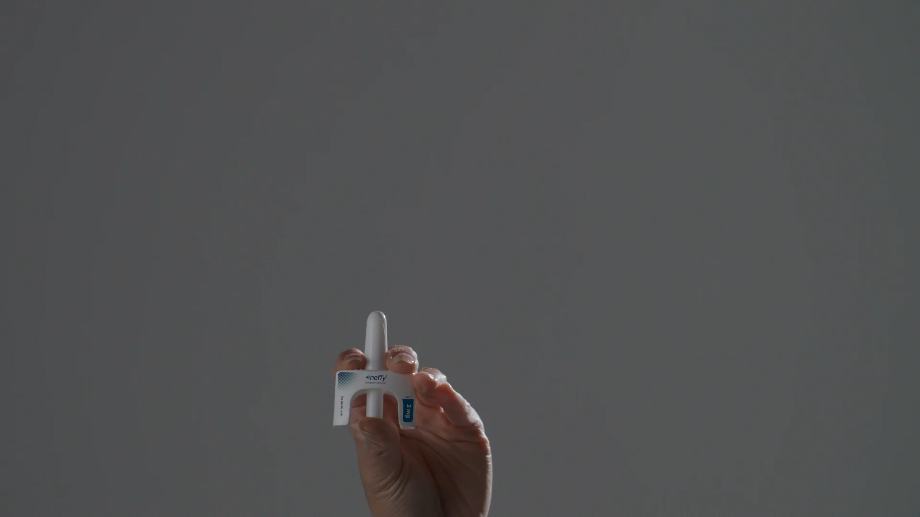
How-to-Use Videos for neffy® (epinephrine nasal spray)

Slide 20
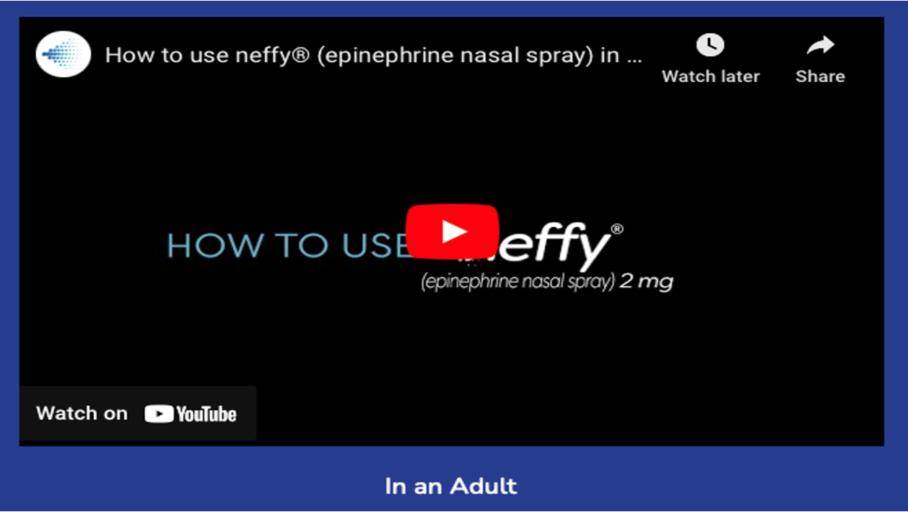

How-to-Use Videos for neffy® (epinephrine nasal spray)

Slide 21
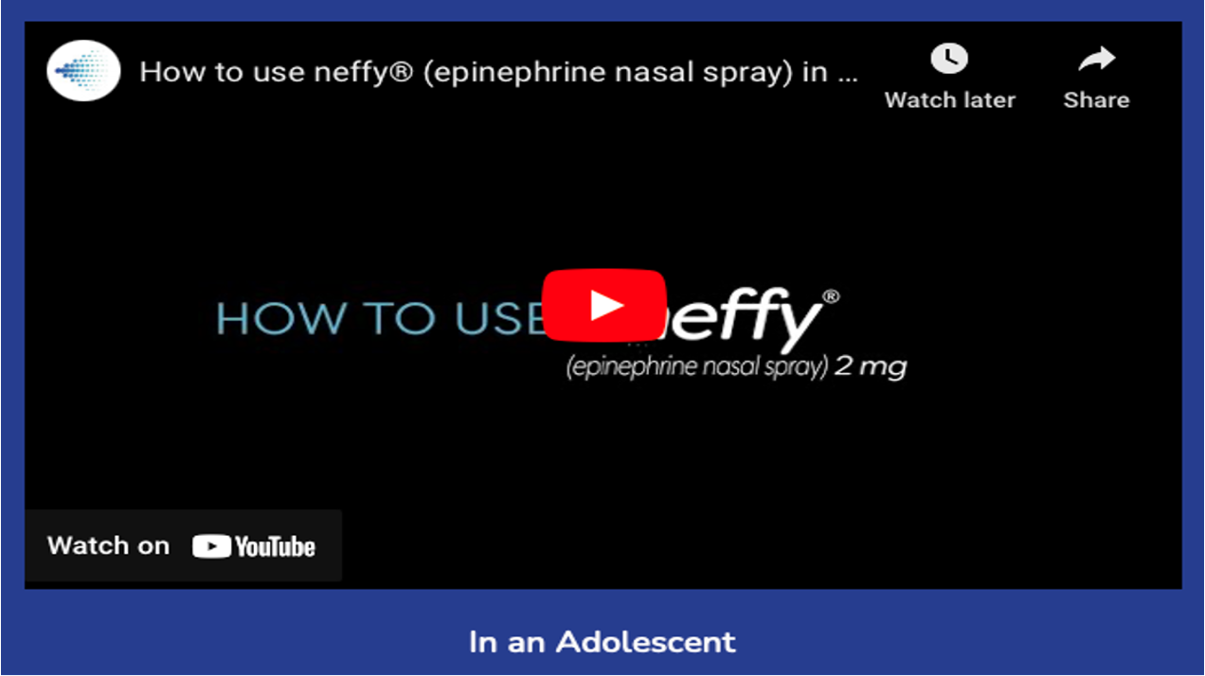
How-to-Use Videos for neffy® (epinephrine nasal spray)

Slide 22
Thank You
For additional information and to order a neffy demo device, see visit www.neffypro.com or contact
ARS Medical Information
Email: medinfo@ars-pharma.com
Phone: 877-MYNEFFY (877-696-3339) /Option 1
©2024 ARS Pharmaceuticals Operations, Inc. All rights reserved. ”ARS Pharma,” the ARS Pharma logo design, “neffy,” and the neffy logo, are trademarks or registered trademarks of ARS Pharmaceuticals Operations, Inc. NEF-US-0284 I 09/2024

